Slide 1
The design and development of AIRYL

Slide 2

Debayan De
Rohit Das
Rudra Nil Basu
Sumitra Chowdhury
BitCoders

Slide 3
What is AIRYL?

Slide 4
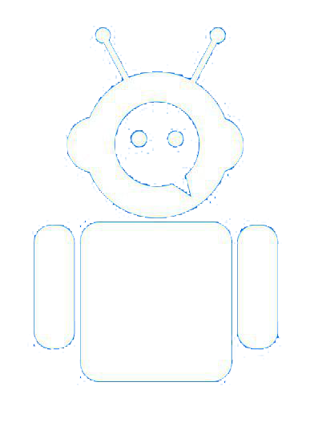
What is AIRYL?
A chatbot based on AIML
Based on Android
Fully documented using Sphinx
Open Sourced
Under MIT License
github.com/PhoenixRRDS/AIRYL

Slide 5
DEMO

Slide 6
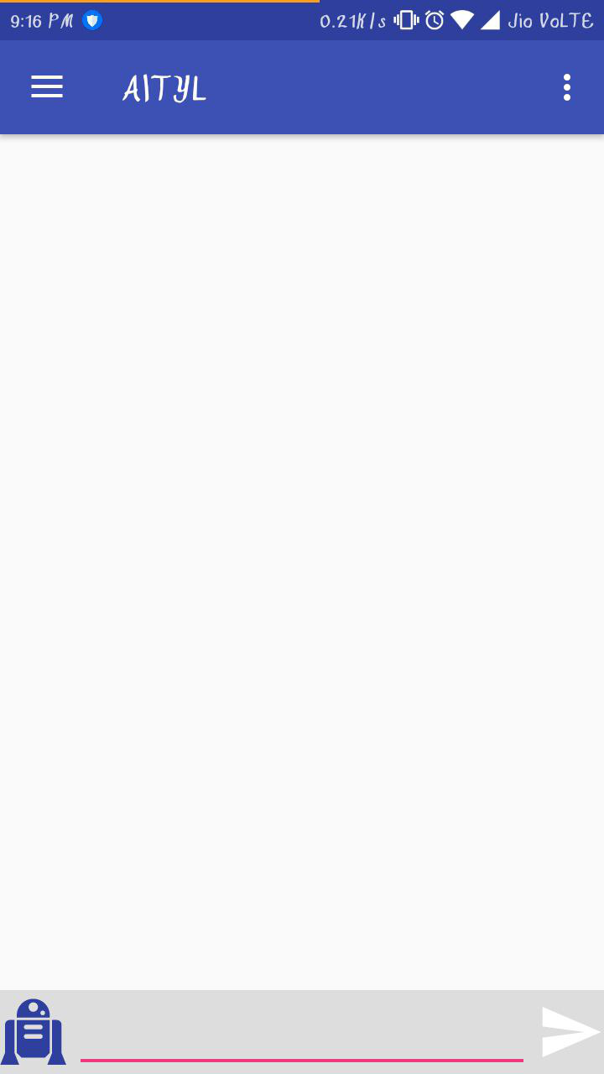
DEMO

Slide 7
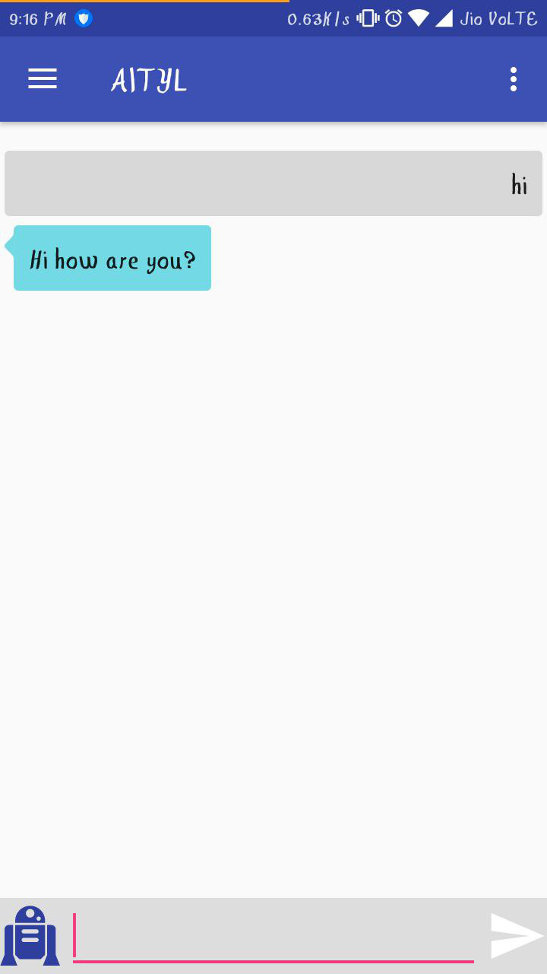
DEMO

Slide 8
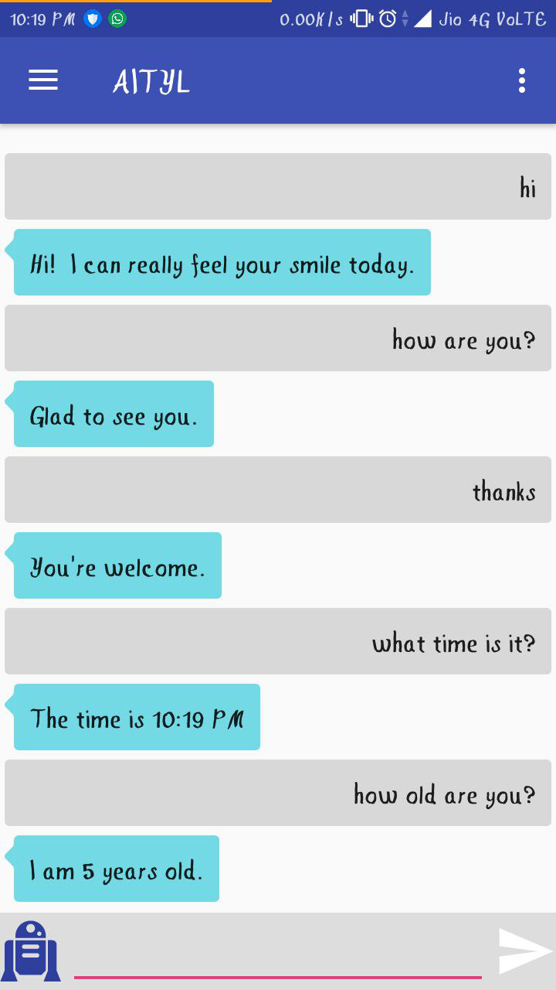
DEMO

Slide 9
ROADMAP
History of AI Debayan De
Alicebot and AIML Rohit Das
Android Implementation Rudra Nil Basu
Documentation using Sphinx Sumitra Chowdhury
Project workflow Rudra Nil Basu
Future work
github.com/PhoenixRRDS/AIRYL

Slide 10

1. History of AI
Debayan De
/RudraNilBasu

Slide 11
2. Alicebot and AIML
Rohit Das
/RudraNilBasu

Slide 12
3. Android implementation
Rudra Nil Basu
/RudraNilBasu

Slide 13
4. Documentation using Sphinx
Sumitra Chowdhury
/RudraNilBasu

